Slide 1
oTree
Philipp Chapkovski
Higher School of Economics
July 28-August 3, 2019

Slide 2
Link to access:
http://bit.ly/imprs2019

Slide 3
Day 1
oTree admin interface
Studies on mTurk
Creating the first app
oTree project and app structure
Python intro

Slide 4
Day 2
Trust game
Constants
Roles
Page functions (is_displayed, …)
Relational databases
oTree data structure
Tests

Slide 5
Day 3
Public good game
Treatments
Templates
Money
Deployment on Heroku

Slide 6
Day 5
Public good game with punishment
Bootstrap
getattr, setattr
mTurk
Deployment on Heroku

Slide 7
Day 4
Matching
Dynamic group composition (group_by_arrival_time)
Dynamic fields (min, max, choices)
Matching
Chaining apps

Slide 8
Exam
30 minutes
Build a simple app based on provided instructions

Slide 9
oTree: alternatives
Lioness http://lioness-lab.org/ - G34, gm15, (Gaechter et al. 'Conducting interactive experiments online' 2018 Experimental Economics)
NodeGame nodegame.org (G8, gm27, 47 Stars, 6 Forks on GitHub)
Gorilla gorilla.sc, proprietary, see paper in PsyArXiv 2018
Sophie https://www.sophielabs.com/ (gm48, Last release 2016)
BreadBoard http://breadboard.yale.edu - Proto stage network project with Christakis (22 Stars, 7 Forks on GitHub)
…
oTree (www.otree.org), (G102, gm890, 219 Stars, 103 Forks on GitHub)

Slide 10
oTree
platform to run interactive online experiments
written on Python
open source
based on Django framework
responsive – can be run in mobile browsers, tablets etc.
Materials and code : | https://chapkovski.github.io/teaching/
My e-mail: | chapkovski@gmail.com
oTree support group: | https://groups.google.com/forum/#!forum/otree
oTree documentation: | http://otree.readthedocs.org/
oTree Hub: | https://www.otreehub.com/

Slide 11
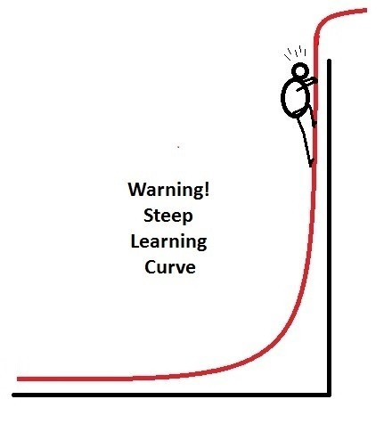
oTree
Languages: Python (backend); HTML, JavaScript, Django template language (frontend)
Backend: Django (M-V-C)
Frontend: Bootstrap
(https://getbootstrap.com)

Slide 12
Our apps:
https://imprs-uncertainty.herokuapp.com/

Slide 13
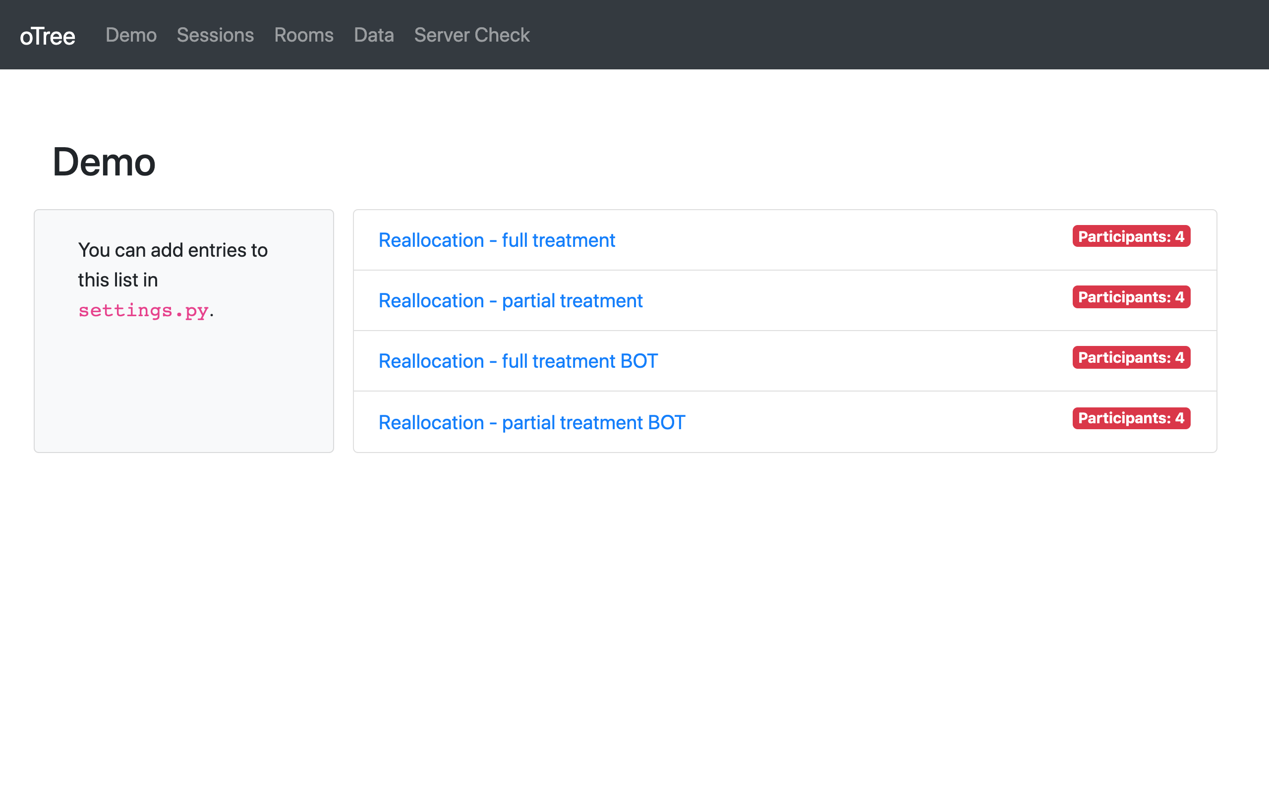
oTree Admin interface

Slide 14
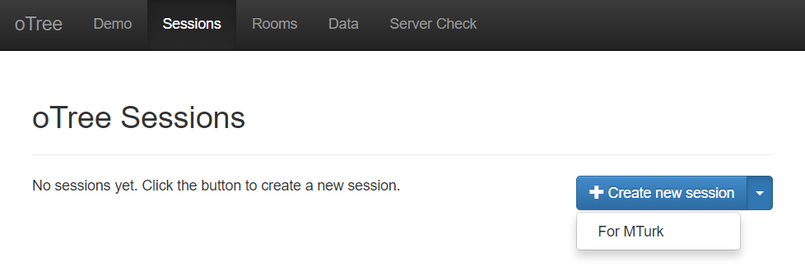
mTurk - BigFive

Slide 15
The first oTree app. Step 1/2
Open the terminal (MacOS), or PowerShell/Command line (Windows)
Check if oTree is installed: otree –version
Create a new project: otree startproject NAMEOFPROJECT
Create a new app:
Change to NAMEOFPROJECT folder: cd NAMEOFPROJECT
Create an app: otree startapp NAMEOFAPP

Slide 16
The first oTree app. Step 2/2
Open NAMEOFPROJECT in PyCharm (or in any other editor of your choice)
register app to settings.py:
SESSION_CONFIGS = [ { 'name': 'my_first_app', 'display_name': "My First App", 'num_demo_participants': 1, 'app_sequence': [' NAMEOFPROJECT '], }, ]
In Terminal: otree devserver
in any browser go to: http://localhost:8000

Slide 17
Three steps to add a new Page
Add Page class definition to pages.py
Add page reference to page_sequence
Create PageName.html in app/templates/app folder

Slide 18
Three steps to get input from user
Define model field in models.py
Add form_fields and form_model to a corresponding Page in pages.py
Add {% formfields %} in the Page template

Slide 19


Our main goal:
Show something to the participant.
Get his/her reaction on it

Slide 20
Models
Pages
Templates

Slide 21
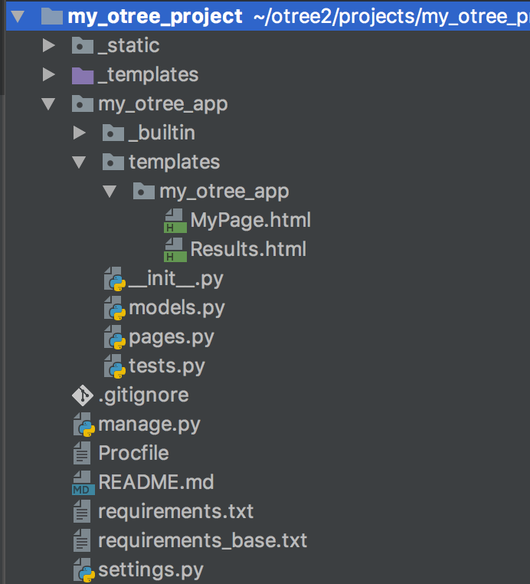

Slide 22
Models are responsible for storing and processing data in the database
Anything that you need to be stored should be defined as a field in models.py file
Models
Pages
Templates

Slide 23
Pages are responsible for retrieving and passing back data from models to templates and vice versa.
If you need to show something to a participant or to get his/her input, you need to state in pages.py
Models
Pages
Templates

Slide 24
Templates are just ordinary html files which get the info from pages and show it to a participant.
As soon as a participant clicks ‘Next’ the data he enters is passed back to pages
Models
Pages
Templates

Slide 25

This is session.
The entire set of all participants in your lab
or online

Slide 26
This is participant.
The entire set of all participants in your lab
or online

Slide 27
Subsession
is a set of all players in one round

Slide 28
Player is an element of
subsession

Slide 29
One participant
contains the info
about all players
who he/she
‘owns’

Slide 30
The group
is a set of players
in one particular
subsession

Slide 31
One session can contain several apps

Slide 32
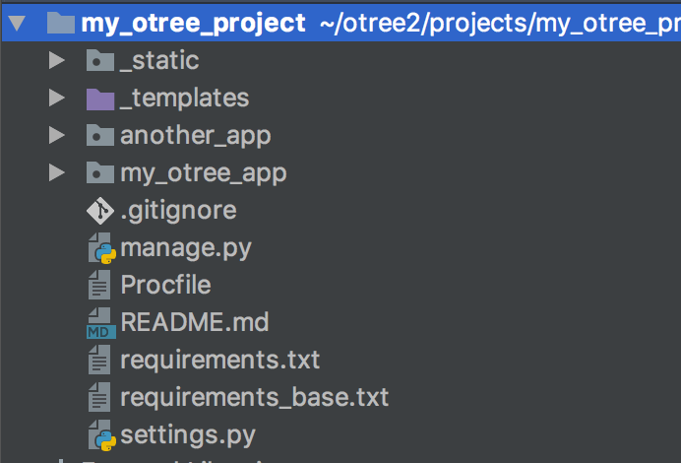
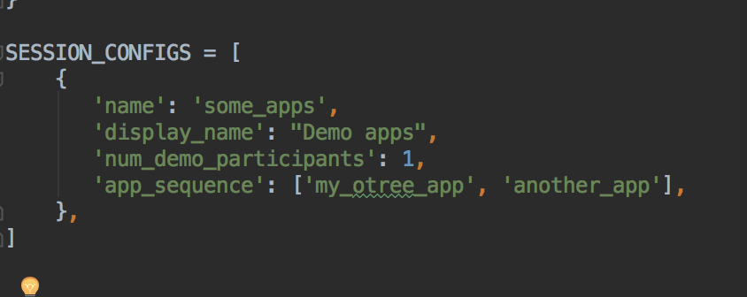
One session can contain several apps
in settings.py:

Slide 33

Very brief introduction

Slide 34
Structure of oTree app
Pages
Page classes
page_sequence
Models
Constants
Player, Group, Subsession
App definition in settings.py
Displaying logic
Data processing

Slide 35
models.py
Constants: fixed set of global parameters, remaining the same for the entire app
Subsession model: data that can change from session to session and from round to round, for the entire set of participants in the specific session
Group model: data that remains the same for the group of players in the specific round (example: total contribution in PGG, Sender's decision in DG/TG)
Player model: data for individual decision makers

Slide 36
models.py
class Constants(BaseConstants): # Base constants of oTree name_in_url = 'myotreeapp' players_per_group = 2 num_rounds = 1 # Any custom parameters: endowment = 100 class Subsession(BaseSubsession): treatment = models.StringField(initial='baseline') class Group(BaseGroup): total_investment = models.IntegerField(initial=100) class Player(BasePlayer): contribution = models.IntegerField(initial=10)

Slide 37
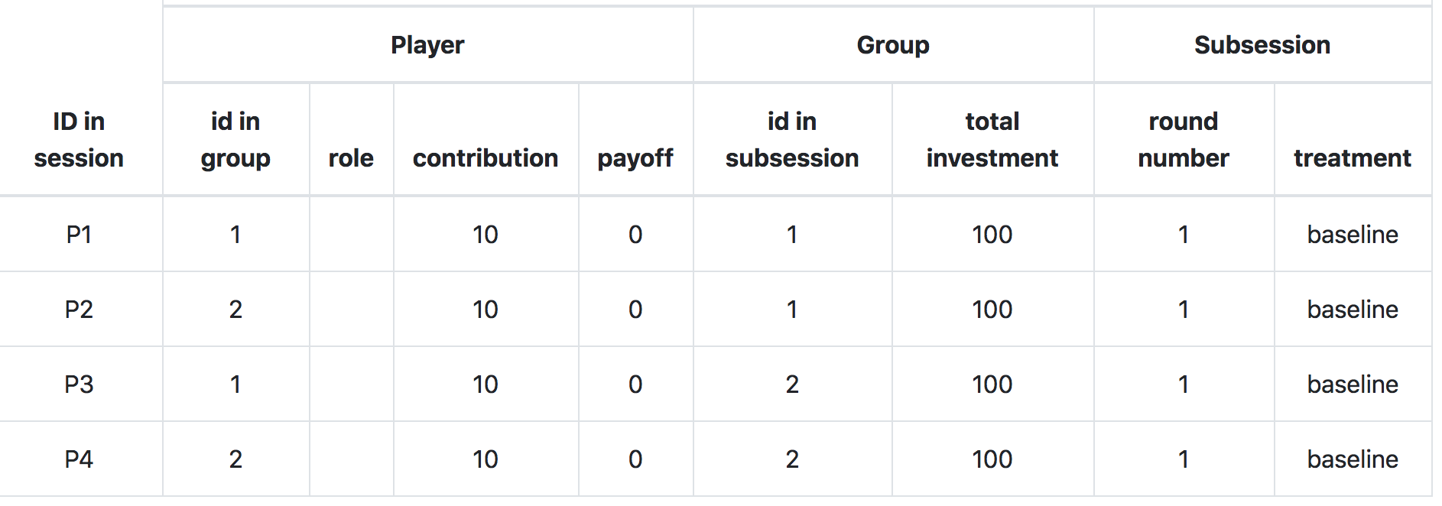
models.py

Slide 38
creating_session method
Subsession model has a special method creating_session
The code there will be executed just before the session starts.
It will be executed as many times as many rounds the game has.
It is used for randomizing initial values and assign treatments
Subsession model also has two other methods:
get_players()
get_groups()

Slide 39
creating_session method
The following code will randomize total investment per group and contribution per individual player:
import random class Subsession(BaseSubsession): def creating_session(self): for g in self.get_groups(): g.total_investment = random.randint(0, 100) for p in self.get_players(): p.contribution = random.randint(0, 10)

Slide 40
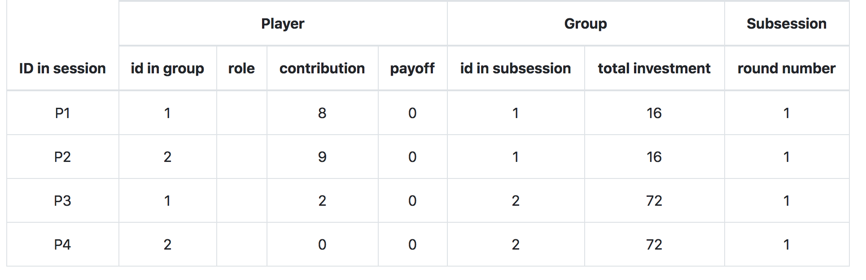
creating_session method
The following code will randomize total investment per group and contribution per individual player:
Result:

Slide 41
player model
built-in attributes:
id_in_group
id_in_subsession
payoff
round_number
DB referrals: participant, group, subsession, session
built-in methods:
get_others_in_group()
get_others_in_subsession()
in_round, in_previous_rounds, in_all_rounds

Slide 42
group model
built-in attributes:
id_in_subsession
round_number
DB referrals: subsession, session
built-in methods:
get_players()
set_players()
get_player_by_id(ID)
get_player_by_role(ROLE)

Slide 43
Anatomy of an oTree Page
Page creation:
class definition
template
When/if/for whom it is shown:
position in page_sequence
is_displayed method
What is shown:
vars_for_template method
What to do next:
before_next_page method

Slide 44
Anatomy of an oTree Page
class MyPage(Page):
form_model = 'player'
form_fields = ['my_field']
page_sequence = [MyPage]

Slide 45
Field form(s) on a template
{% fieldform player.my_field label= ‘Enter something’ %}
OR:
{% for field in form %}
{% formfield field %}
{% endfor %}
OR:
{% formfields %}
OR:
{{ form }}

Slide 46
Methods of an oTree Page
BEFORE page is shown:
is_displayed (should return True if page is to be shown)
vars_for_template (should return variables in a form of dictionary)
AFTER page is shown:
before_next_page

Slide 47
Dynamic set of forms
in Page class:
class MyPage(Page):
def get_form_fields(self):
if self.player.treatment == 'A':
return ['a', 'b']
else:
return ['c', 'd']

Slide 48
Dynamic min/max
you have a field donation; different endowments
in Page class:
class MyPage(Page):
def donation_max(self):
return self.player.endowment

Slide 49
Templates: using variables
In a template you can access variables defined in vars_for_template of the specific page:
{{ var }}
You can also use lists and dictionaries
You can also access any variable in Constants, Player, Group…
{{ player.payoff }}
{{ participant.payoff }}

